Slide 1
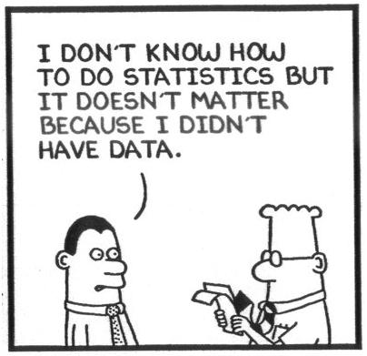
Measurement Error Models in Action:
The Latest Methods and Their Applications in Nutrition and Environmental Health
SER 2026
Phoenix, AZ
Donna Spiegelman
donna.spiegelman@yale.edu
Study Design in the Presence of Exposure Misclassification or Measurement Error

Slide 2
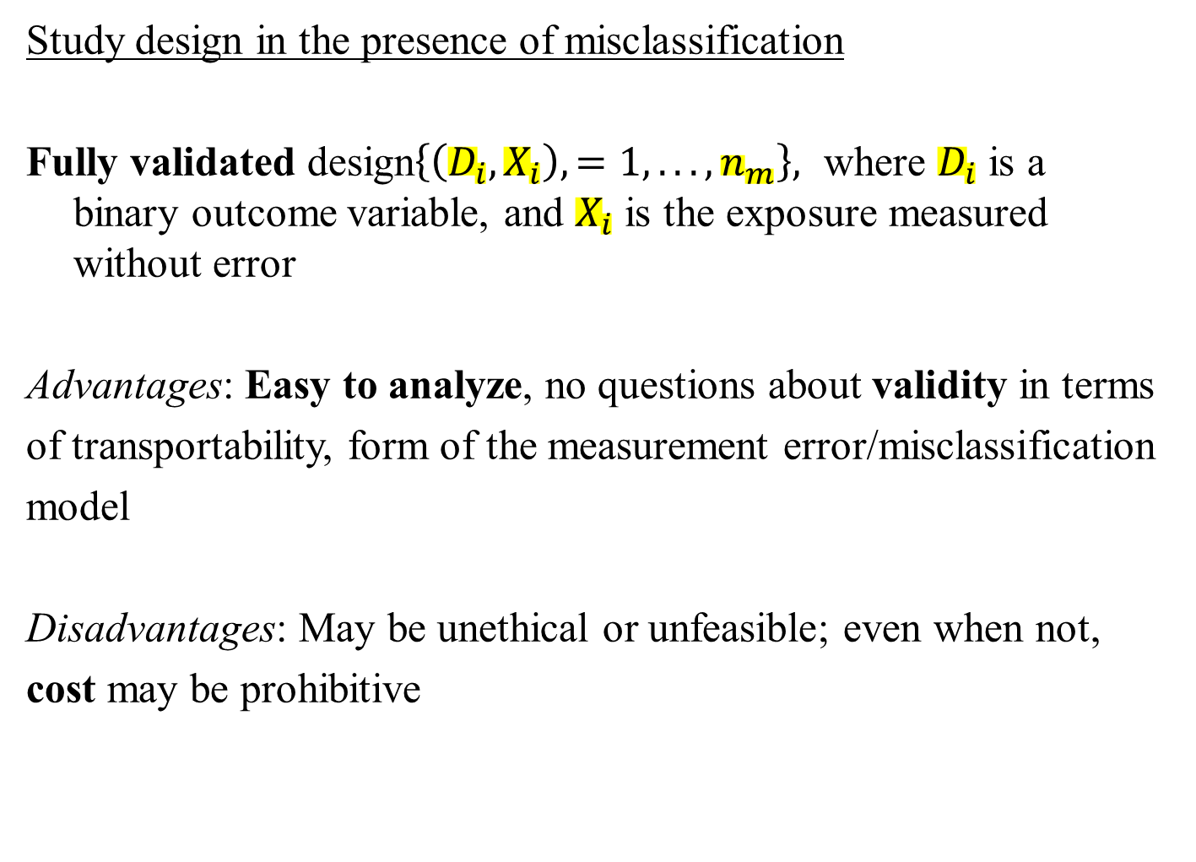
Study design in the presence of misclassification
Fully validated design$\left\{\left(D_{i},X_{i}\right),=1,...,n_{m}\right\},$ where $D_{i}$ is a binary outcome variable, and $X_{i}$ is the exposure measured without error
Advantages: Easy to analyze, no questions about validity in terms
of transportability, form of the measurement error/misclassification
model
Disadvantages: May be unethical or unfeasible; even when not,
cost may be prohibitive
2
Notes:
2

Slide 3
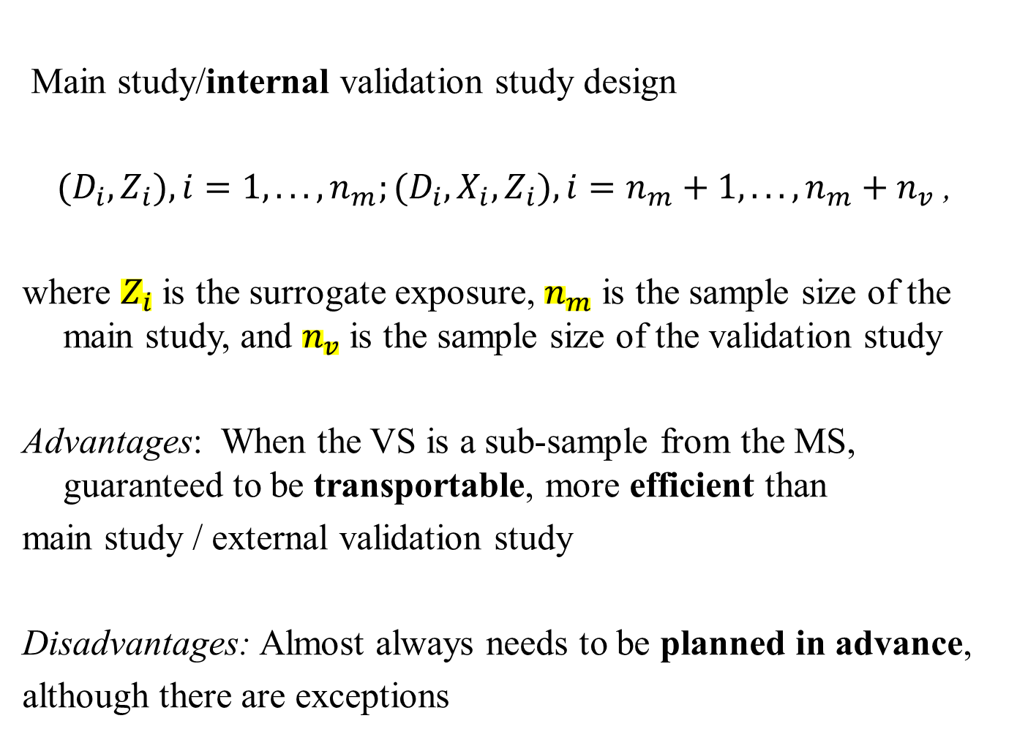
Main study/internal validation study design
$(D_{i},Z_{i}),i=1,...,n_{m};(D_{i},X_{i},Z_{i}),i=n_{m}+1,...,n_{m}+n_{v}$ ,
where $Z_{i}$ is the surrogate exposure, $n_{m}$ is the sample size of the main study, and $n_{v}$ is the sample size of the validation study
Advantages: When the VS is a sub-sample from the MS, guaranteed to be transportable, more efficient than
main study / external validation study
Disadvantages: Almost always needs to be planned in advance,
although there are exceptions
3
Notes:
3

Slide 4
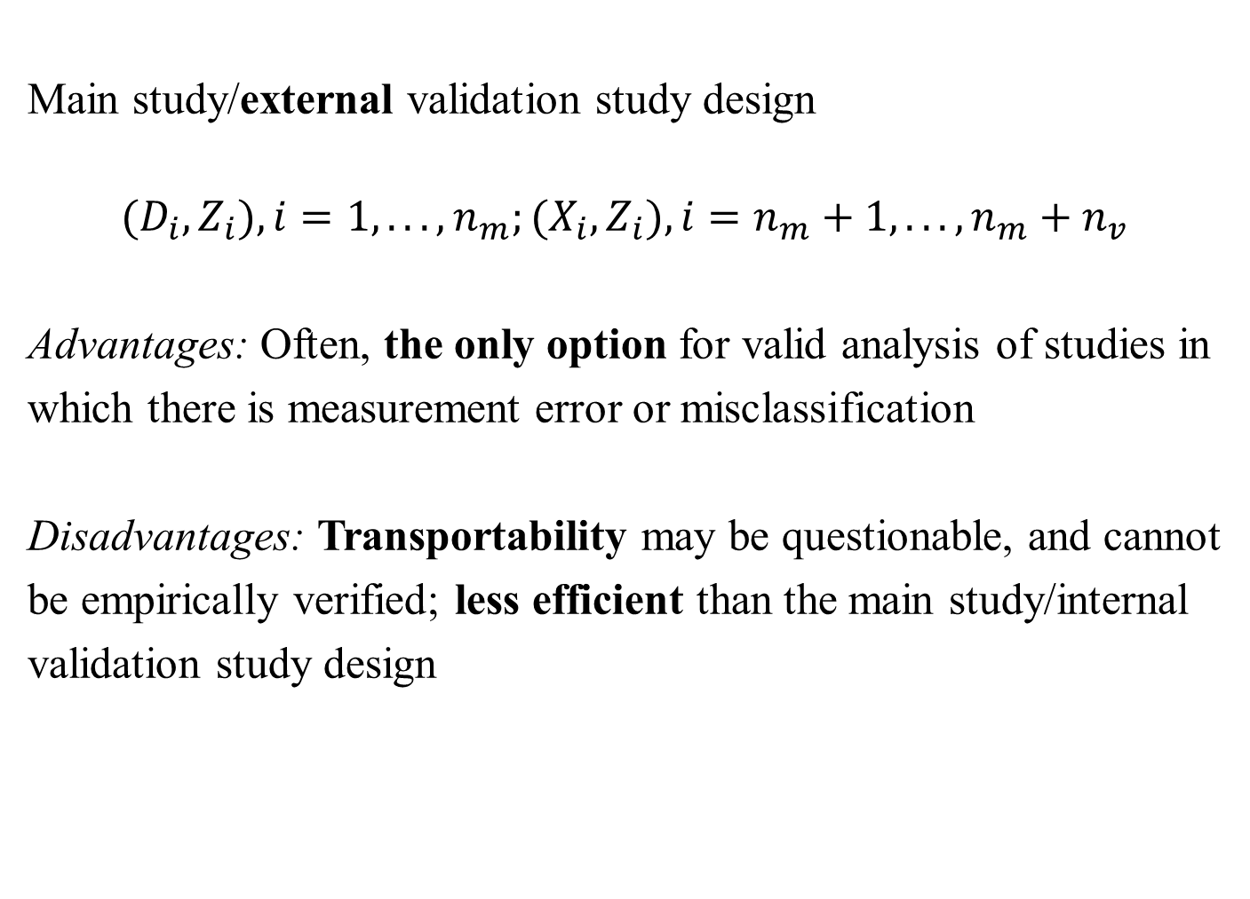
Main study/external validation study design
$$(D_{i},Z_{i}),i=1,...,n_{m};(X_{i},Z_{i}),i=n_{m}+1,...,n_{m}+n_{v}$$
Advantages: Often, the only option for valid analysis of studies in
which there is measurement error or misclassification
Disadvantages: Transportability may be questionable, and cannot
be empirically verified; less efficient than the main study/internal
validation study design
4
Notes:
4

Slide 5
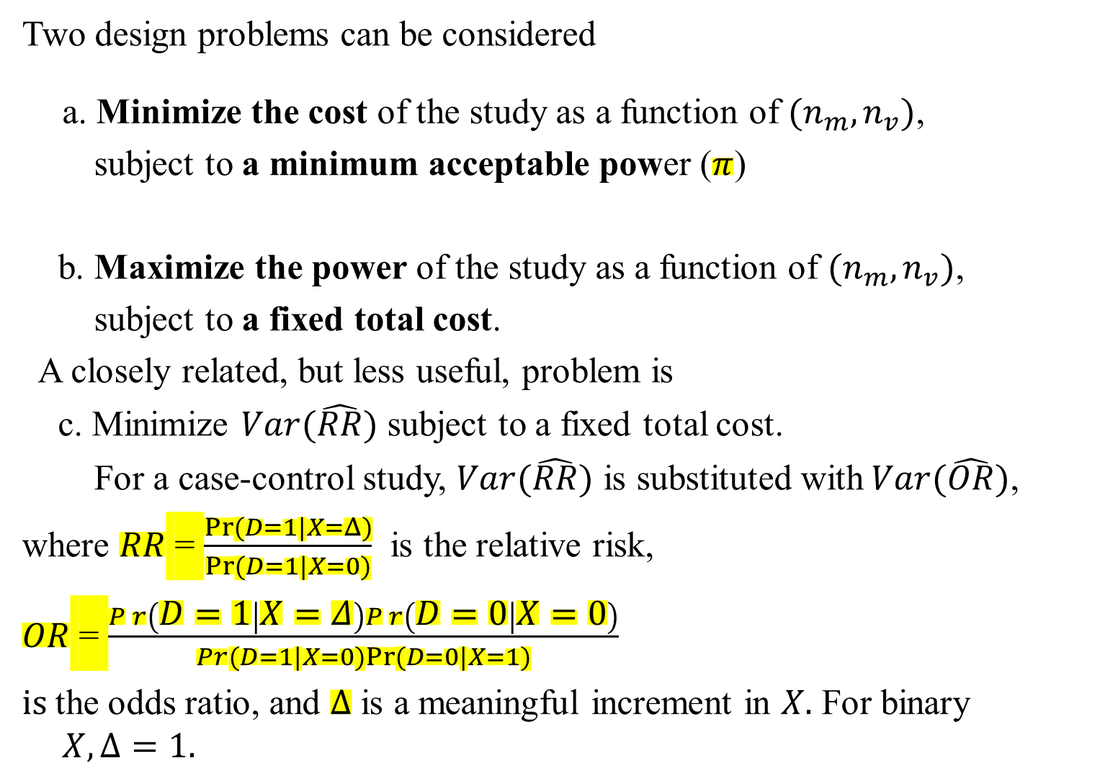
Two design problems can be considered
a. Minimize the cost of the study as a function of $(n_{m},n_{v})$,
subject to a minimum acceptable power ($π$)
b. Maximize the power of the study as a function of $(n_{m},n_{v})$,
subject to a fixed total cost.
A closely related, but less useful, problem is
c. Minimize $Var(\hat{RR})$ subject to a fixed total cost.
For a case-control study, $Var(\hat{RR})$ is substituted with$Var(\hat{OR})$,
where $RR$ = $\frac{Pr⁡(D=1|X=Δ)}{Pr⁡(D=1|X=0)}$ is the relative risk,
$OR$ = $\frac{Pr\left(D=1 | X=Δ\right)Pr\left(D=0 | X=0\right)}{Pr⁡(D=1|X=0)Pr⁡(D=0|X=1)}$
$is$the odds ratio, and $Δ$ is a meaningful increment in $X.$ For binary $X, Δ=1.$
5
Notes:
5

Slide 6
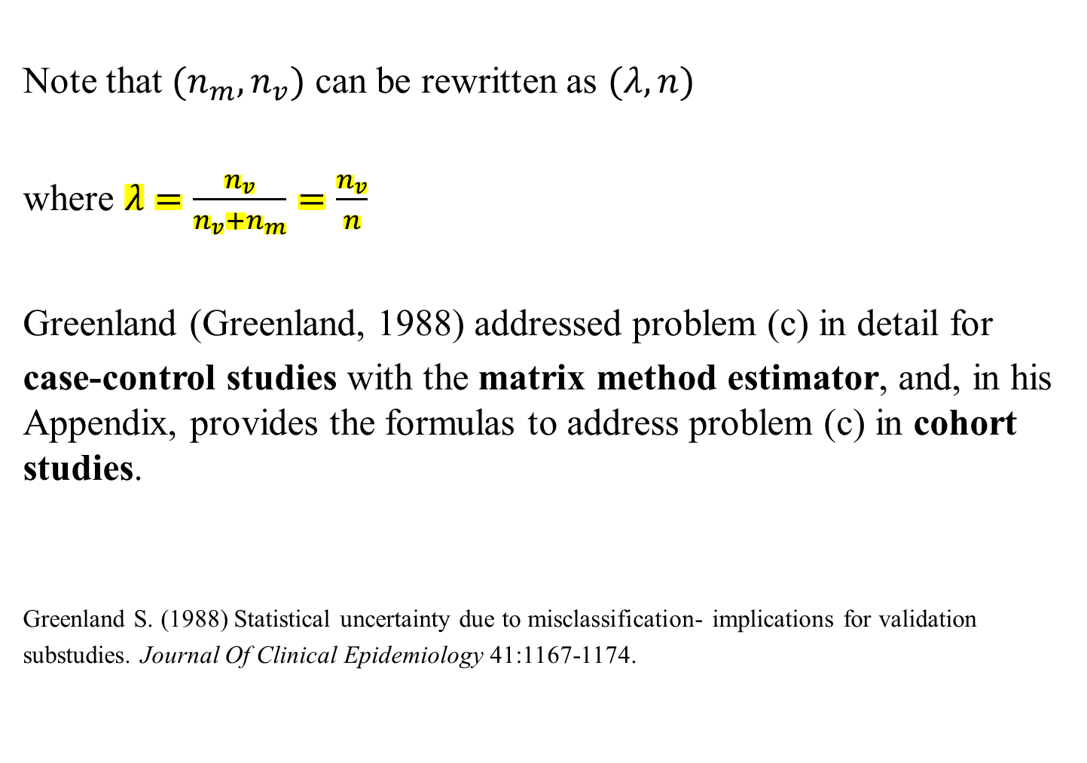
Note that $(n_{m},n_{v})$ can be rewritten as $(λ,n)$
where $λ=\frac{n_{v}}{n_{v}+n_{m}}=\frac{n_{v}}{n}$
Greenland (Greenland, 1988) addressed problem (c) in detail for
case-control studies with the matrix method estimator, and, in his Appendix, provides the formulas to address problem (c) in cohort studies.
Greenland S. (1988) Statistical uncertainty due to misclassification- implications for validation
substudies. Journal Of Clinical Epidemiology 41:1167-1174.
6
Notes:
6

Slide 7
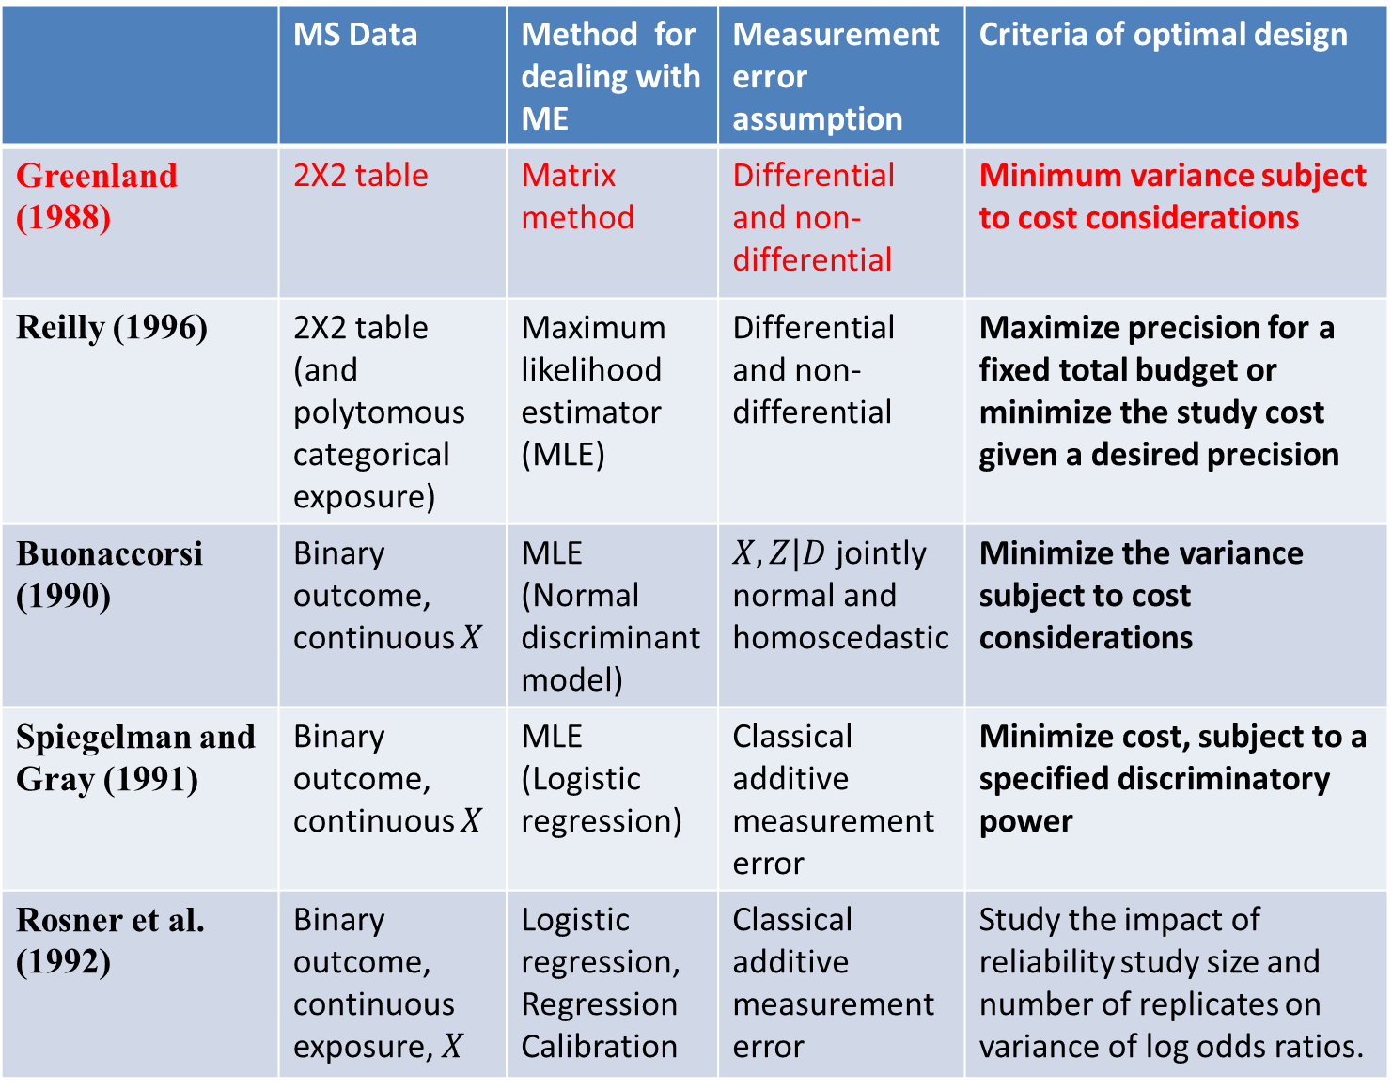
 | MS Data | Method for dealing with ME | Measurement error assumption | Criteria of optimal design
Greenland (1988) | 2X2 table | Matrix method | Differential and non-differential | Minimum variance subject to cost considerations
Reilly (1996) | 2X2 table (and polytomous categorical exposure) | Maximum likelihood estimator (MLE) | Differential and non-differential | Maximize precision for a fixed total budget or minimize the study cost given a desired precision
Buonaccorsi (1990) | Binary outcome, continuous $X$ | MLE (Normal discriminant model) | $X,Z|D$ jointly normal and homoscedastic | Minimize the variance subject to cost considerations
Spiegelman and Gray (1991) | Binary outcome, continuous $X$ | MLE (Logistic regression) | Classical additive measurement error | Minimize cost, subject to a specified discriminatory power
Rosner et al. (1992) | Binary outcome, continuous exposure, $X$ | Logistic regression, Regression Calibration | Classical additive measurement error | Study the impact of reliability study size and number of replicates on variance of log odds ratios.

Slide 8
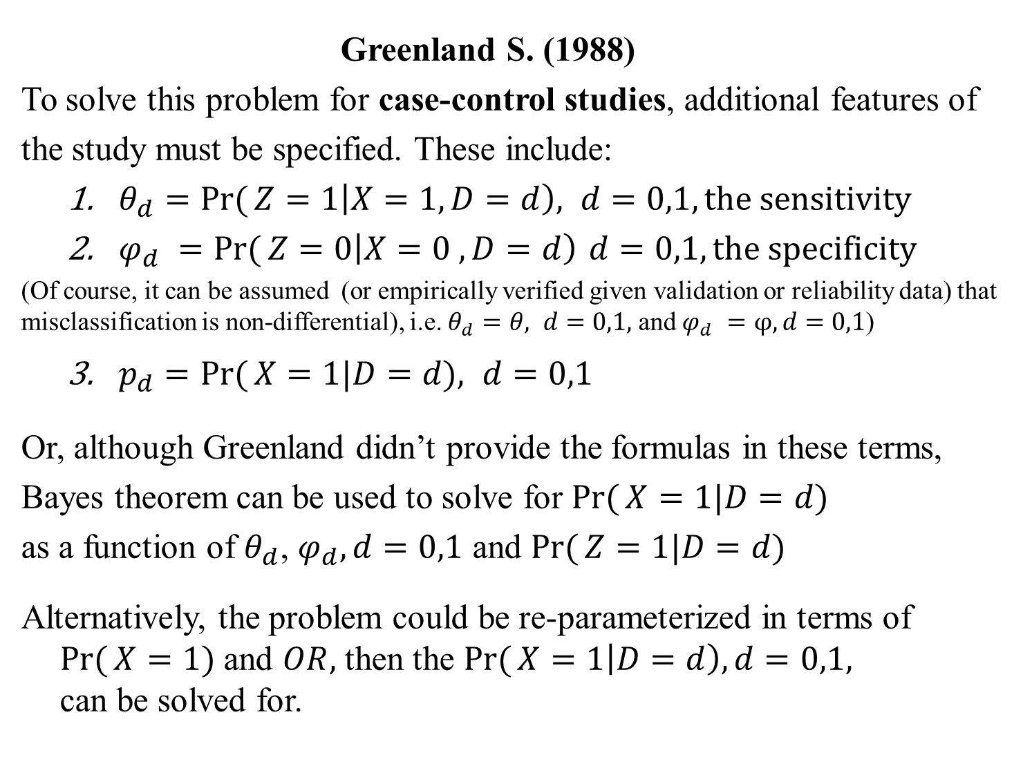
Greenland S. (1988)
To solve this problem for case-control studies, additional features of
the study must be specified. These include:
$θ_{d}=\operatorname{Pr}{(}Z=1\left|X=1,D=d\right), d=0,1,the sensitivity$
$φ_{d }=\operatorname{Pr}{(}Z=0\left|X=0 ,D=d\right) d=0,1, the specificity$
(Of course, it can be assumed (or empirically verified given validation or reliability data) that misclassification is non-differential), i.e. $θ_{d}=θ, d=0,1,$ and $φ_{d }=φ, d=0,1$)
$p_{d}=\operatorname{Pr}{(}X=1|D=d), d=0,1$
Or, although Greenland didn’t provide the formulas in these terms,
Bayes theorem can be used to solve for $\operatorname{Pr}{(}X=1|D=d)$
as a function of $θ_{d}$, $φ_{d},d=0,1$ and $\operatorname{Pr}{(}Z=1|D=d)$
Alternatively, the problem could be re-parameterized in terms of $\operatorname{Pr}{(}X=1)$ and $OR,$ then the $\operatorname{Pr}{(}X=1\left|D=d\right),d=0,1,$ can be solved for.
8
Notes:
8

Slide 9
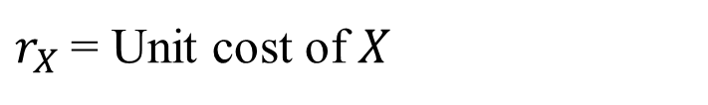

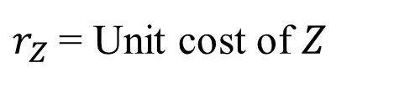
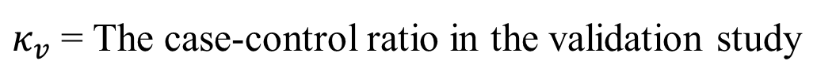
Note: $OR=\frac{Pr\left(D=1 | X=Δ\right)Pr\left(D=0 | X=0\right)}{Pr⁡(D=1|X=0)Pr⁡(D=0|X=1)}= \frac{p_{1}(1−p_{0})}{(1−p_{1})p_{0}}$, and
$κ_{m}$= The case-control ratio in the main study, and
$κ_{v}$= The case-control ratio in the validation study
$r_{Z}$= Unit cost of $Z$
$r_{X}$= Unit cost of $X$
$$D$$
Notes:
9

Slide 10
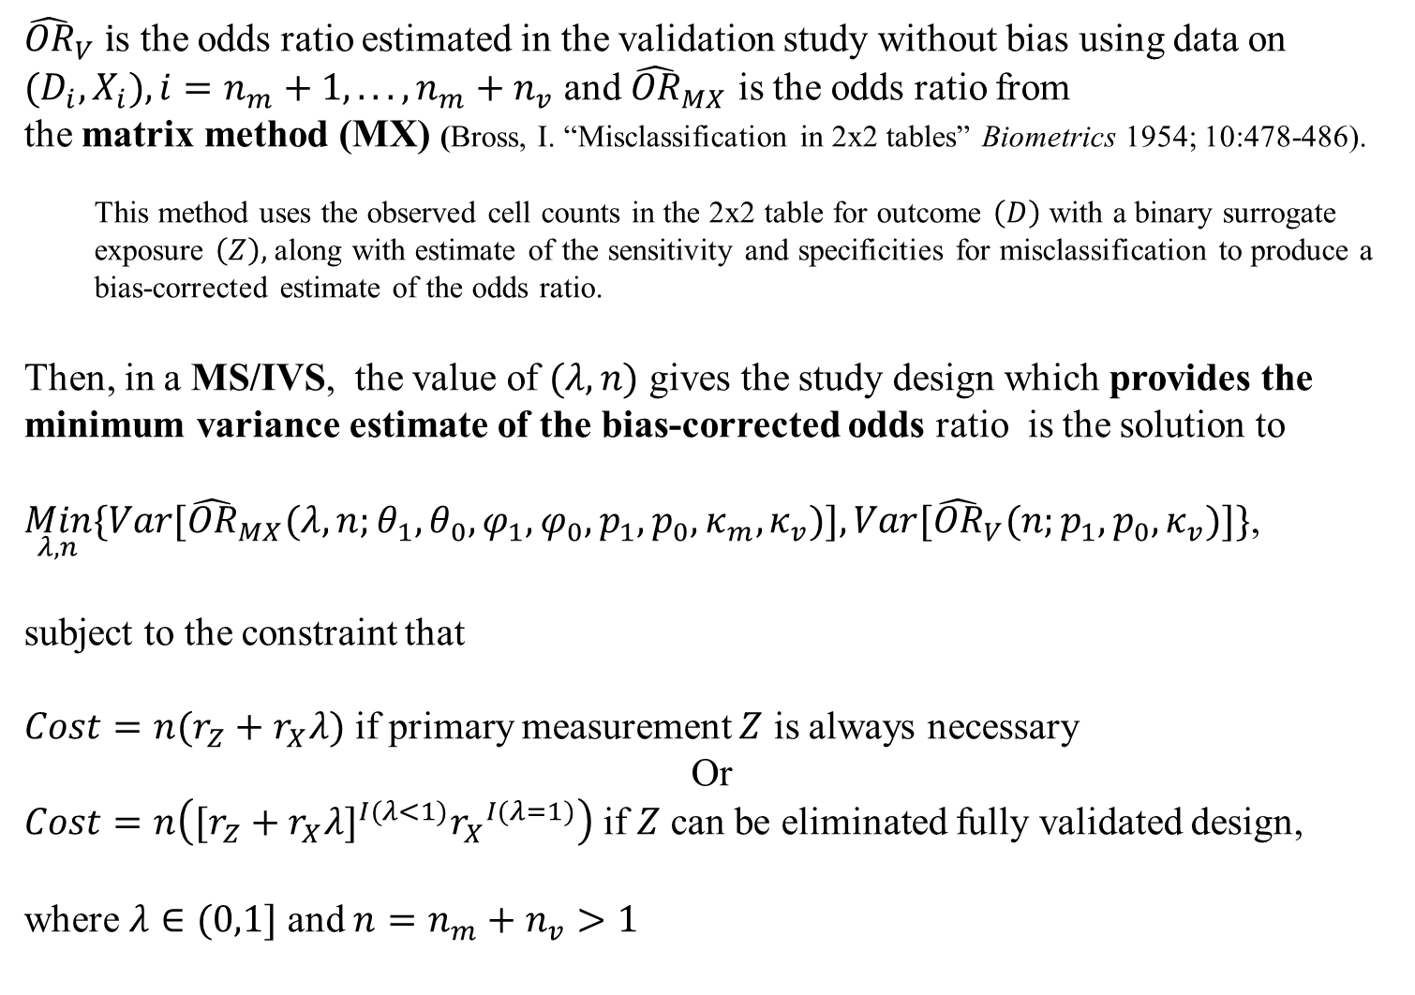
Greenland S. (1988)
${\hat{OR}}_{V} i$s the odds ratio estimated in the validation study without bias using data on $(D_{i},X_{i}),i=n_{m}+1,...,n_{m}+n_{v}$ and ${\hat{OR}}_{MX}$ is the odds ratio from
the matrix method (MX) (Bross, I. “Misclassification in 2x2 tables” Biometrics 1954; 10:478-486).
This method uses the observed cell counts in the 2x2 table for outcome $\left(D\right)$ with a binary surrogate exposure $\left(Z\right),$ along with estimate of the sensitivity and specificities for misclassification to produce a bias-corrected estimate of the odds ratio.
Then, in a MS/IVS, the value of $(λ,n)$ gives the study design which provides the minimum variance estimate of the bias-corrected odds ratio is the solution to
$\underset{λ,n}{Min}\{Var[{\hat{OR}}_{MX}(λ,n;θ_{1},θ_{0},φ_{1},φ_{0},p_{1},p_{0},κ_{m},κ_{v})],Var[{\hat{OR}}_{V}(n;p_{1},p_{0},κ_{v})]\}$,
subject to the constraint that
$Cost=n(r_{Z}+r_{X}λ)$ if primary measurement $Z$ is always necessary
Or
$Cost=n\left([r_{Z}+r_{X}λ]^{I(λ<1)}{r_{X}}^{I(λ=1)}\right)$if $Z$ can be eliminated fully validated design,
where $λ∈(0,1]$ and $n=n_{m}+n_{v}>1$
Notes:
10

Slide 11
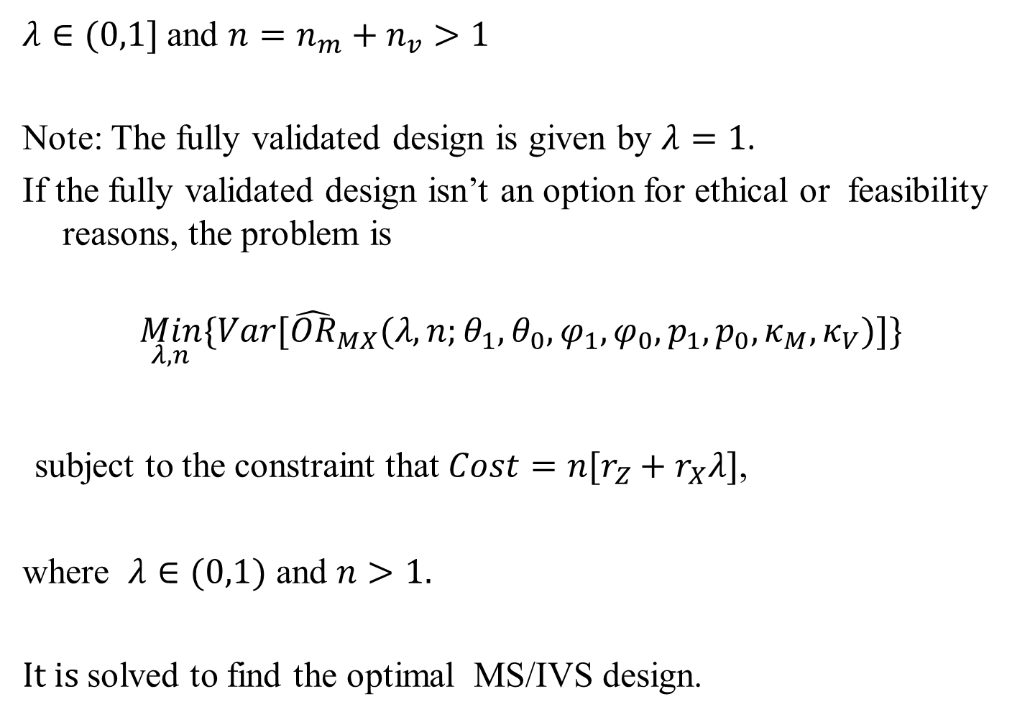

$$\operatorname{Pr}{(}Z=1|D=d)$$
Greenland S. (1988)
$λ∈(0,1]$ and $n=n_{m}+n_{v}>1$
Note: The fully validated design is given by $λ=1$.
If the fully validated design isn’t an option for ethical or feasibility reasons, the problem is
$$\underset{λ,n}{Min}\{Var[{\hat{OR}}_{MX}(λ,n;θ_{1},θ_{0},φ_{1},φ_{0},p_{1},p_{0},κ_{M},κ_{V})]\}$$
subject to the constraint that $Cost=n[r_{Z}+r_{X}λ]$,
where $λ∈(0,1)$ and $n>1.$
$It is$solved to find the optimal MS/IVS design.
11
Notes:
11

Slide 12



















Table 4: Optimal proportion $λ_{opt}$ for validation substudy as a function of the cost ratio $R=r_{X}/r_{Z}$
(assuming parameter values equal values observed in the SIDS data)
$$R$$
 | <=3 | 4 | 5 | 6 | 8 | 10
I. Assuming differential misclassification
A. Assuming primary measurement always necessary
 | 1.00 | 0.87 | 0.77 | 0.71 | 0.61 | 0.55
ARE at | 1.00 | 1.00 | 0.99 | 0.98 | 0.97 | 0.95
Relative | 1.00 | 0.90 | 0.81 | 0.75 | 0.65 | 0.59
B. Assuming primary measurement can be eliminated if
$$λ_{opt}=1.00$$ and ARE=1.00 for all R <=14
II. Assuming nondifferential misclassification
A. Assuming primary measurement always necessary
 | 1.00 | 0.11 | 0.07 | 0.06 | 0.04 | 0.04
ARE at | 1.00 | 0.90 | 0.80 | 0.72 | 0.60 | 0.52
Relative | 1.00 | 0.27 | 0.22 | 0.19 | 0.15 | 0.13
B. Assuming primary measurement can be eliminated if
 | 1.00 | 1.00 | 0.07 | 0.06 | 0.04 | 0.04
ARE at | 1.00 | 1.00 | 0.96 | 0.84 | 0.68 | 0.57
Relative | 1.00 | 1.00 | 0.27 | 0.23 | 0.16 | 0.14
* Asymptotic efficiency of design with , relative to design with . Ratio of study size when to study size when (assuming the same expenditure for measurement in both designs).
$$λ_{opt}$$
$$λ=1.0∗$$
$$N†$$
$$λ=1.0$$
$$λ_{opt}$$
$$λ=1.0$$
$N$ $†$
$$λ=1.0$$
$$λ_{opt}$$
$$λ=1.0$$
$$N†$$
$$λ=1.0$$
$$λ=λ_{opt}$$
$$†$$
$$λ=1.0$$
$$λ=λ_{opt}$$
What is the relative cost of the measurement, $R$, for your study?
For NHS, it has been estimated at 500.
12
Notes:
12

Slide 13






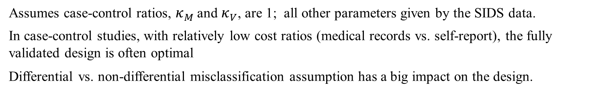
$$†$$
Assumes case-control ratios, $κ_{M}$ and $κ_{V}$, are 1; all other parameters given by the SIDS data.
In case-control studies, with relatively low cost ratios (medical records vs. self-report), the fully validated design is often optimal
Differential vs. non-differential misclassification assumption has a big impact on the design.
13
Notes:
13

Slide 14
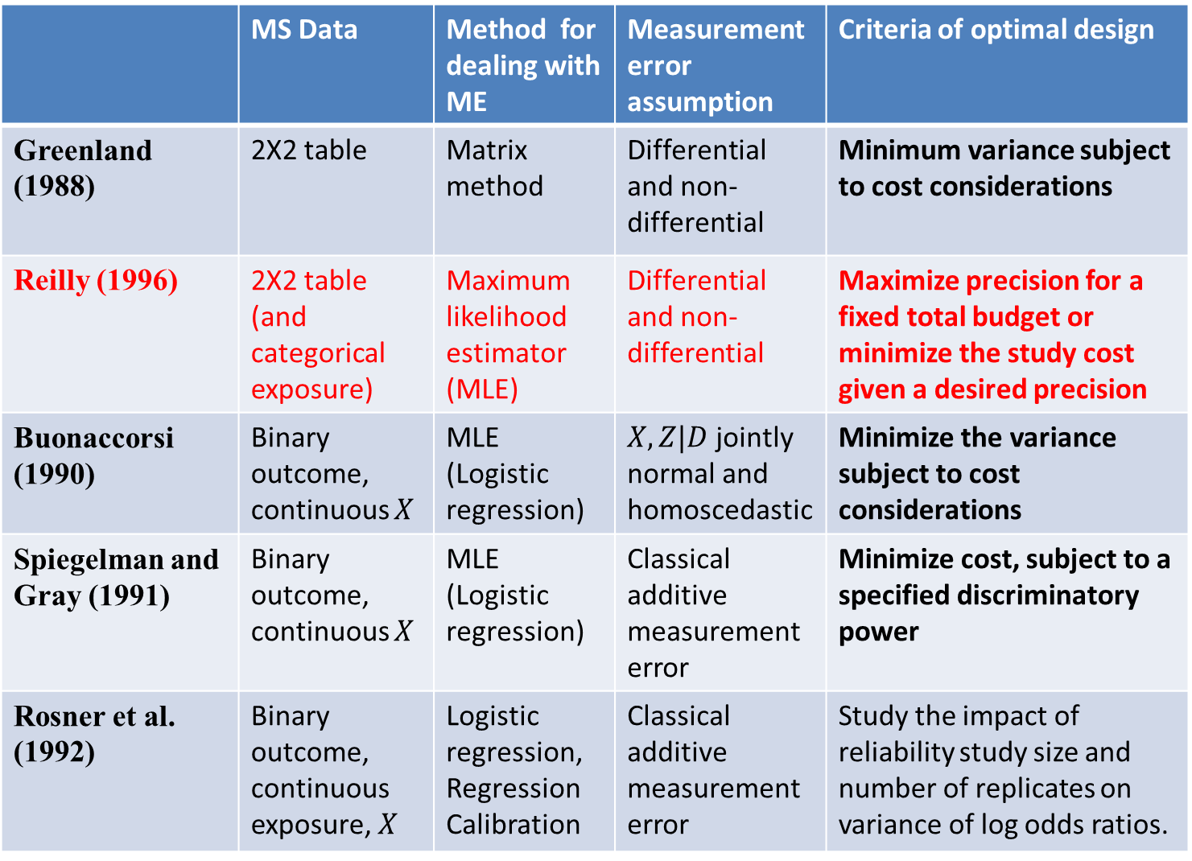
 | MS Data | Method for dealing with ME | Measurement error assumption | Criteria of optimal design
Greenland (1988) | 2X2 table | Matrix method | Differential and non-differential | Minimum variance subject to cost considerations
Reilly (1996) | 2X2 table (and categorical exposure) | Maximum likelihood estimator (MLE) | Differential and non-differential | Maximize precision for a fixed total budget or minimize the study cost given a desired precision
Buonaccorsi (1990) | Binary outcome, continuous $X$ | MLE (Logistic regression) | $X,Z|D$ jointly normal and homoscedastic | Minimize the variance subject to cost considerations
Spiegelman and Gray (1991) | Binary outcome, continuous $X$ | MLE (Logistic regression) | Classical additive measurement error | Minimize cost, subject to a specified discriminatory power
Rosner et al. (1992) | Binary outcome, continuous exposure, $X$ | Logistic regression, Regression Calibration | Classical additive measurement error | Study the impact of reliability study size and number of replicates on variance of log odds ratios.

Slide 15
Reilly M. (1996)
Unlike Greenland’s development, which bases optimal design choices on
the matrix method estimator, this method uses the MLE assuming differential misclassification, and considers the MS/IVS design alone.
In Stata, findit meanscor will direct you to sg156, from where you can get this package. Click the installation file and click to install the ancillary files. When done, typing help meanscor gives detailed help. findit optimal offers a list of packages, and you can scroll down to sxd2 and click on the "click here to install" to get the commands.
The criterion is to maximize precision for a fixed total budget or minimize the study cost given a desired precision.
It is known that with the MS/IVS design under differential misclassification, the MLE is equivalent to the inverse matrix method (Lyles, 2002) and that the efficiency loss from using the matrix method can be considerable.
Reilly M. (1996) Optimal sampling strategies for two-stage studies. American Journal of
Epidemiology 143:92-100.
Lyles R.H. (2002) A note on estimating crude odds ratios in case-control studies with differentially
misclassified exposure. Biometrics 58:1034-1036.
15
Notes:
15

Slide 16
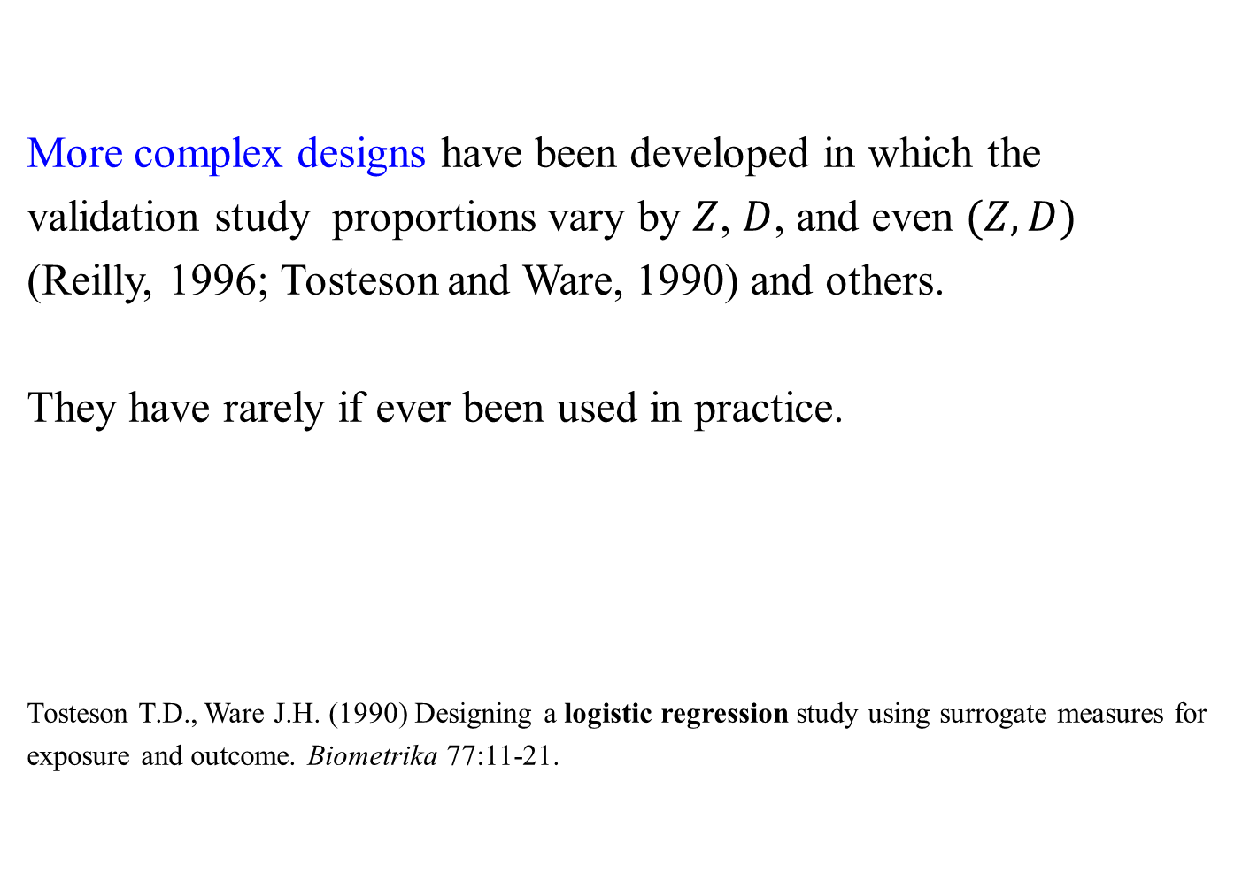
More complex designs have been developed in which the
validation study proportions vary by $Z$, $D$, and even $(Z,D)$
(Reilly, 1996; Tosteson and Ware, 1990) and others.
They have rarely if ever been used in practice.
Tosteson T.D., Ware J.H. (1990) Designing a logistic regression study using surrogate measures for
exposure and outcome. Biometrika 77:11-21.
16
Notes:
16

Slide 17
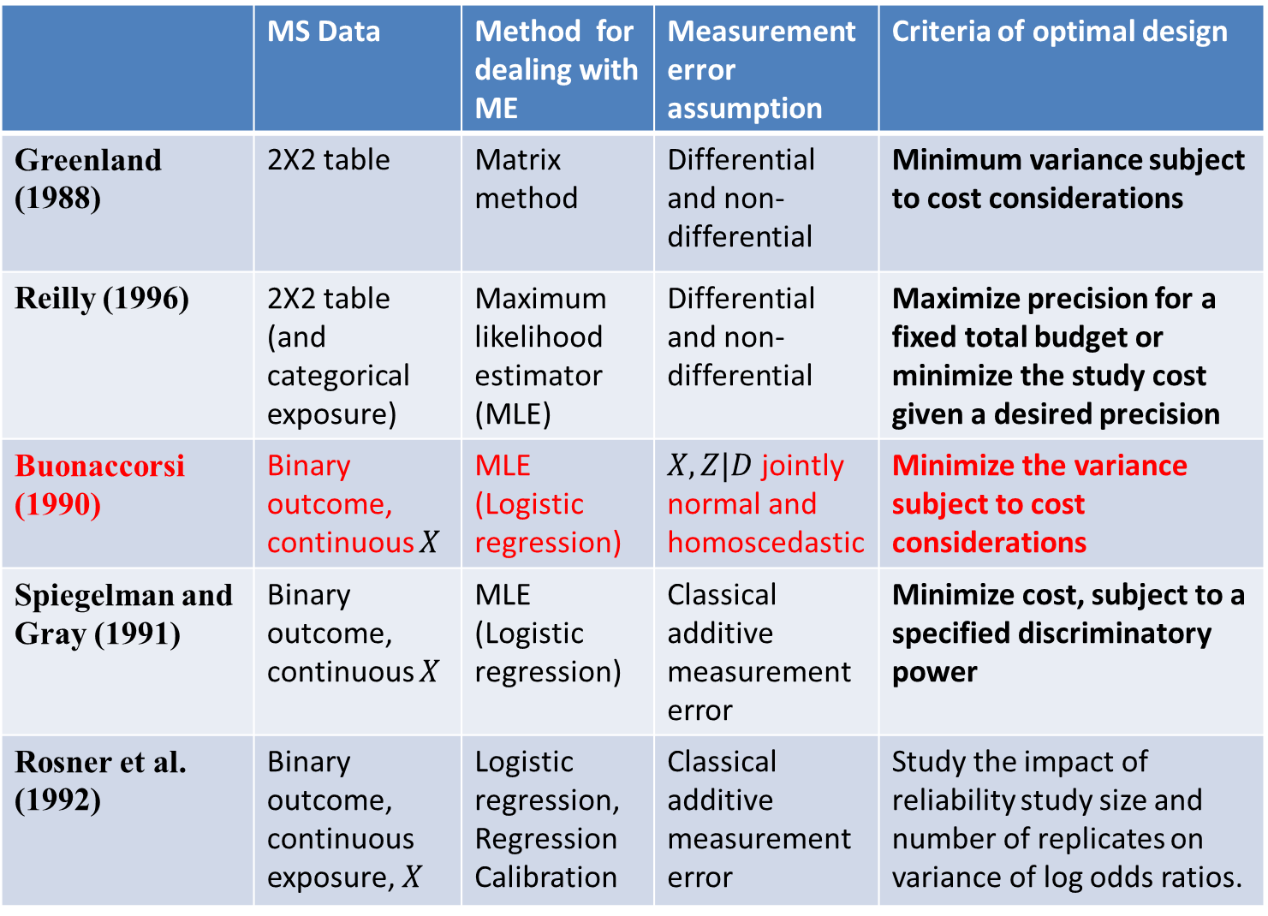
 | MS Data | Method for dealing with ME | Measurement error assumption | Criteria of optimal design
Greenland (1988) | 2X2 table | Matrix method | Differential and non-differential | Minimum variance subject to cost considerations
Reilly (1996) | 2X2 table (and categorical exposure) | Maximum likelihood estimator (MLE) | Differential and non-differential | Maximize precision for a fixed total budget or minimize the study cost given a desired precision
Buonaccorsi (1990) | Binary outcome, continuous $X$ | MLE (Logistic regression) | $X,Z|D$ jointly normal and homoscedastic | Minimize the variance subject to cost considerations
Spiegelman and Gray (1991) | Binary outcome, continuous $X$ | MLE (Logistic regression) | Classical additive measurement error | Minimize cost, subject to a specified discriminatory power
Rosner et al. (1992) | Binary outcome, continuous exposure, $X$ | Logistic regression, Regression Calibration | Classical additive measurement error | Study the impact of reliability study size and number of replicates on variance of log odds ratios.

Slide 18
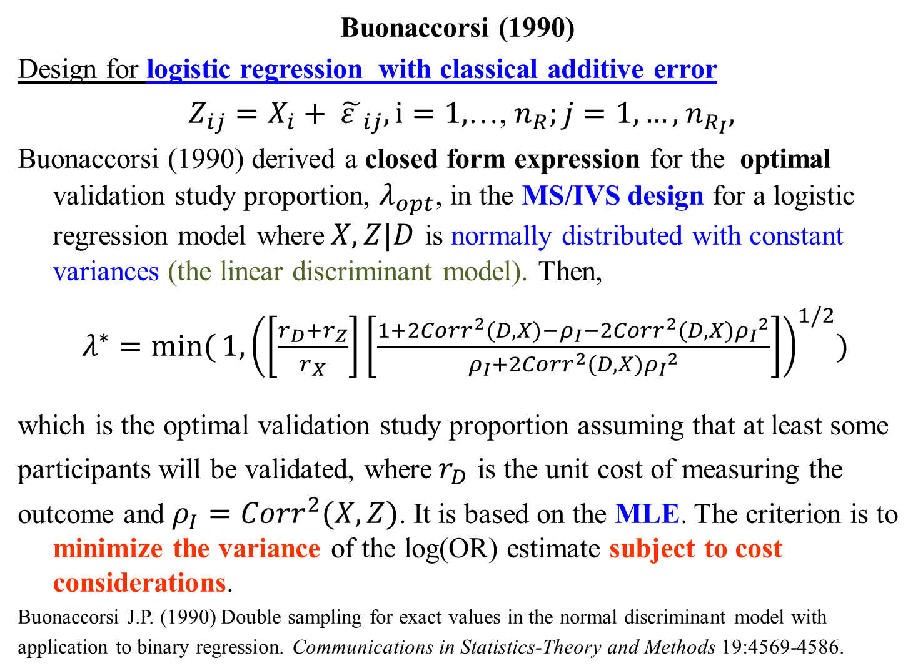
Buonaccorsi (1990)
Design for logistic regression with classical additive error
$Z_{ij}=X_{i}+ {\tilde{ε }}_{ij}, i=1,$…, $n_{R};j=1,…,$ $n_{R_{I}},$
Buonaccorsi (1990) derived a closed form expression for the optimal validation study proportion, $λ_{opt}$, in the MS/IVS design for a logistic regression model where$X,Z|D$ is normally distributed with constant variances (the linear discriminant model). Then,
$λ^{∗}=\min{(}1,{\left(\left[\frac{r_{D}+r_{Z}}{r_{X}}\right]\left[\frac{1+2Corr^{2}(D,X)−ρ_{I}−2Corr^{2}(D,X){ρ_{I}}^{2}}{ρ_{I}+2Corr^{2}(D,X){ρ_{I}}^{2}}\right]\right)}^{1/2})$
which is the optimal validation study proportion assuming that at least some
participants will be validated, where${ r}_{D}$ is the unit cost of measuring the
outcome and $ρ_{I}={Corr}^{2}(X,Z)$. It is based on the MLE. The criterion is to minimize the variance of the log(OR) estimate subject to cost considerations.
Buonaccorsi J.P. (1990) Double sampling for exact values in the normal discriminant model with
application to binary regression. Communications in Statistics-Theory and Methods 19:4569-4586.
18
Notes:
18

Slide 19
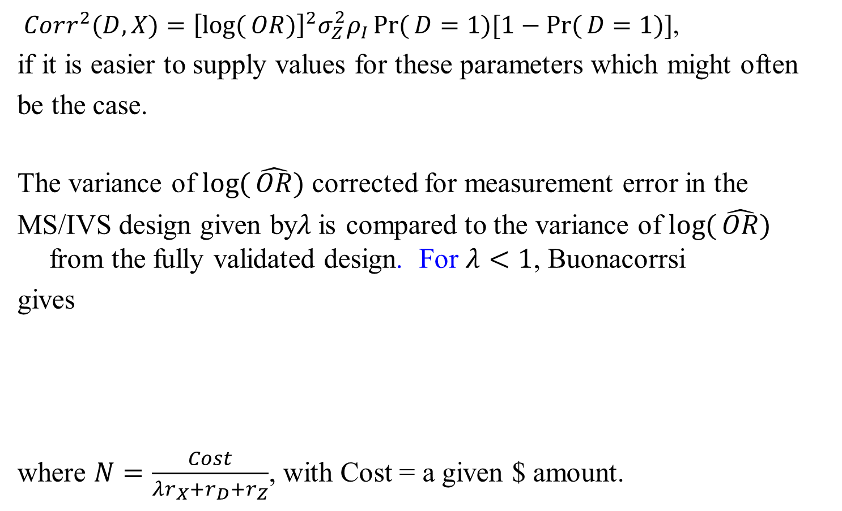
$Corr^{2}(D,X)={\left[\log{(}OR)\right]}^{2}σ_{Z}^{2}ρ_{I}\operatorname{Pr}{(}D=1)[1−\operatorname{Pr}{(}D=1)]$,
if it is easier to supply values for these parameters which might often
be the case.
The variance of $\log{(}\hat{OR})$ corrected for measurement error in the
MS/IVS design given by$λ$is compared to the variance of $\log{(}\hat{OR})$ from the fully validated design. For $λ<1$, Buonacorrsi
gives
where $N=\frac{Cost}{λr_{X}+r_{D}+r_{Z}}$, with Cost = a given $ amount.
19
Notes:
19

Slide 20

For $λ≠1$, the optimal MS/IVS needs to be compared to the fully
validated design to find the final $λ_{opt}$.
and then $λ_{opt}$is 1 if < , otherwise $λ_{opt}=λ^{∗}$.
Software is not available but perhaps we will write it for next year!
20
Notes:
20

Slide 21
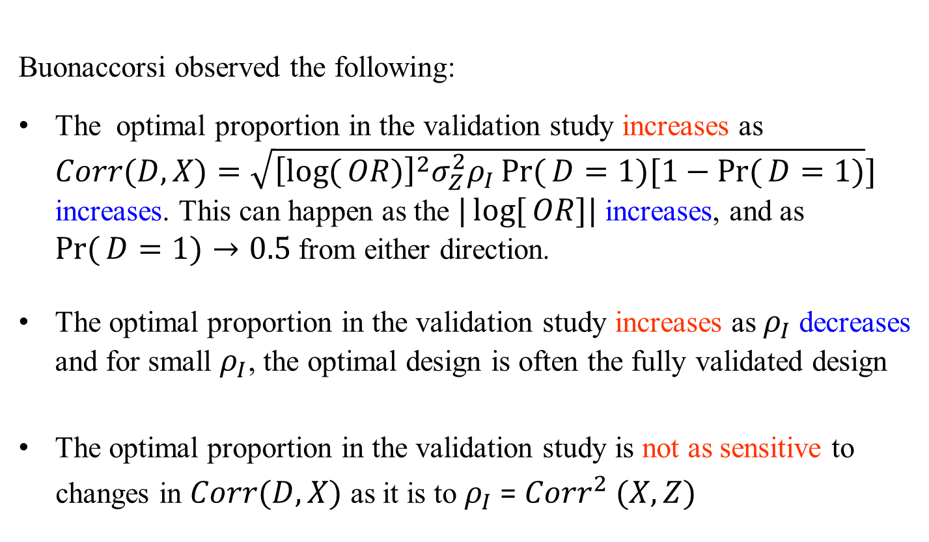
Buonaccorsi observed the following:
The optimal proportion in the validation study increases as $Corr(D,X)=\sqrt{{\left[\log{(}OR)\right]}^{2}σ_{Z}^{2}ρ_{I}\operatorname{Pr}{(}D=1)[1−\operatorname{Pr}{(}D=1)}]$ increases. This can happen as the $|\log{[}OR]|$ increases, and as $\operatorname{Pr}{(}D=1)→0.5$ from either direction.
The optimal proportion in the validation study increases as $ρ_{I}$ decreases and for small $ρ_{I}$, the optimal design is often the fully validated design
The optimal proportion in the validation study is not as sensitive to
changes in $Corr(D,X)$ as it is to $ρ_{I}$ = ${Corr}^{2} (X,Z)$
21
Notes:
21

Slide 22
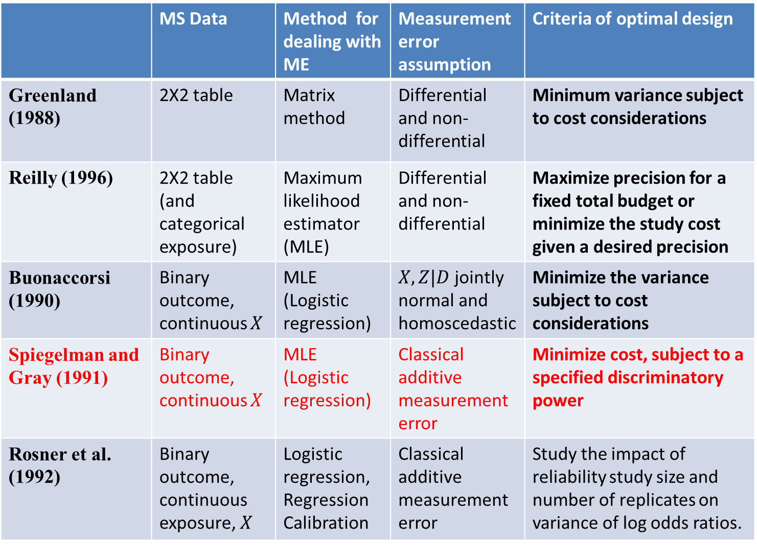
 | MS Data | Method for dealing with ME | Measurement error assumption | Criteria of optimal design
Greenland (1988) | 2X2 table | Matrix method | Differential and non-differential | Minimum variance subject to cost considerations
Reilly (1996) | 2X2 table (and categorical exposure) | Maximum likelihood estimator (MLE) | Differential and non-differential | Maximize precision for a fixed total budget or minimize the study cost given a desired precision
Buonaccorsi (1990) | Binary outcome, continuous $X$ | MLE (Logistic regression) | $X,Z|D$ jointly normal and homoscedastic | Minimize the variance subject to cost considerations
Spiegelman and Gray (1991) | Binary outcome, continuous $X$ | MLE (Logistic regression) | Classical additive measurement error | Minimize cost, subject to a specified discriminatory power
Rosner et al. (1992) | Binary outcome, continuous exposure, $X$ | Logistic regression, Regression Calibration | Classical additive measurement error | Study the impact of reliability study size and number of replicates on variance of log odds ratios.

Slide 23

Spiegelman and Gray (1991)
(Spiegelman and Gray, 1991) considered optimal design when Z|X is
normal and homoscedastic, in contrast to the setting considered by
Buonaccorsi (Buonaccorsi, 1990), which assumes are jointly
normal and homoscedastic. The latter distributional assumptions make
more sense for a case-control study, while the former make more sense
for a cohort study.
Spiegelman D., Gray R. (1991) Cost-efficient study designs for binary response data with Gaussian
covariate measurement error. Biometrics 47:851-869.
23
Notes:
23

Slide 24
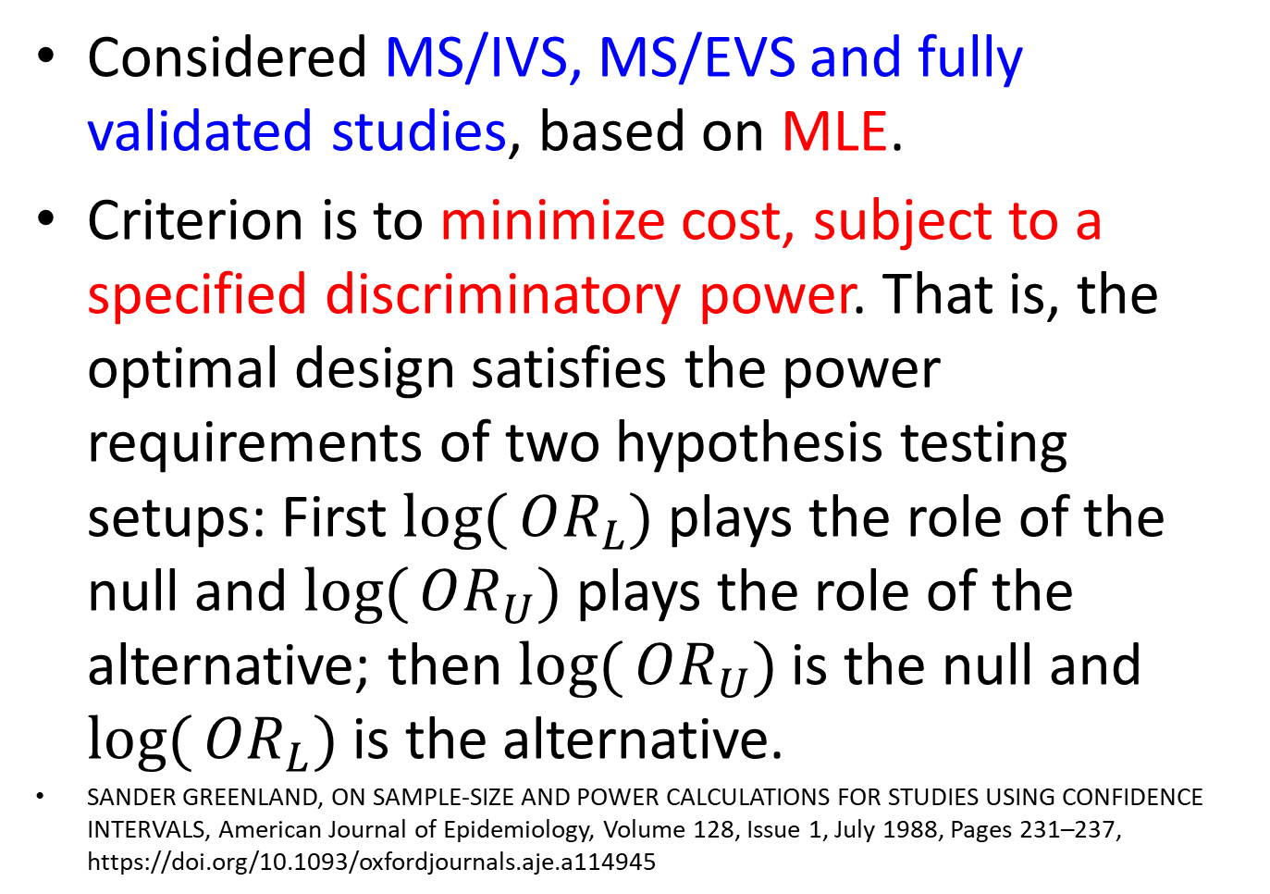
Spiegelman and Gray (1991)
Considered MS/IVS, MS/EVS and fully validated studies, based on MLE.
Criterion is to minimize cost, subject to a specified discriminatory power. That is, the optimal design satisfies the power requirements of two hypothesis testing setups: First $\log{(}OR_{L})$ plays the role of the null and $\log{(}OR_{U})$ plays the role of the alternative; then $\log{(}OR_{U})$ is the null and $\log{(}OR_{L})$ is the alternative.
SANDER GREENLAND, ON SAMPLE-SIZE AND POWER CALCULATIONS FOR STUDIES USING CONFIDENCE INTERVALS, American Journal of Epidemiology, Volume 128, Issue 1, July 1988, Pages 231–237, https://doi.org/10.1093/oxfordjournals.aje.a114945

Slide 25
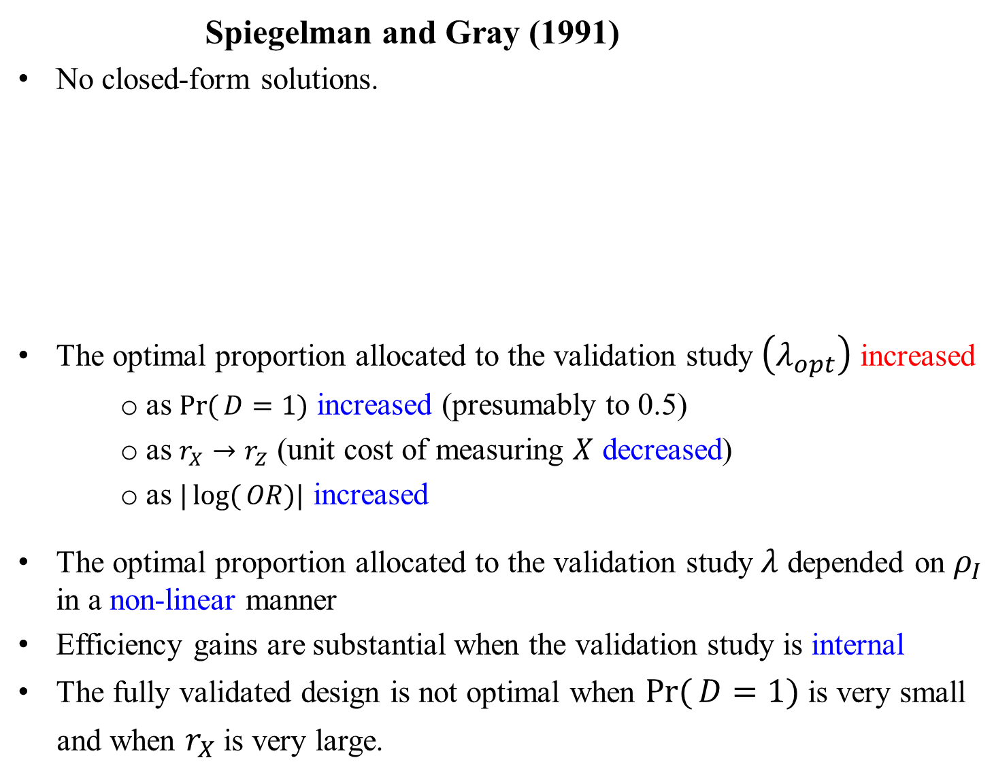
Spiegelman and Gray (1991)
No closed-form solutions.
The optimal proportion allocated to the validation study $\left(λ_{opt}\right)$ increased
as $\operatorname{Pr}{(}D=1)$ increased (presumably to 0.5)
as $r_{X}→r_{Z}$ (unit cost of measuring $X$ decreased)
as $|\log{(}OR)|$ increased
The optimal proportion allocated to the validation study $λ$ depended on $ρ_{I}$ in a non-linear manner
Efficiency gains are substantial when the validation study is internal
The fully validated design is not optimal when $\operatorname{Pr}{(}D=1)$ is very small
and when $r_{X}$ is very large.
25
Notes:
25

Slide 26
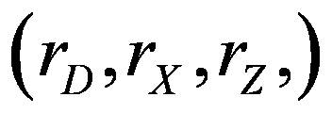
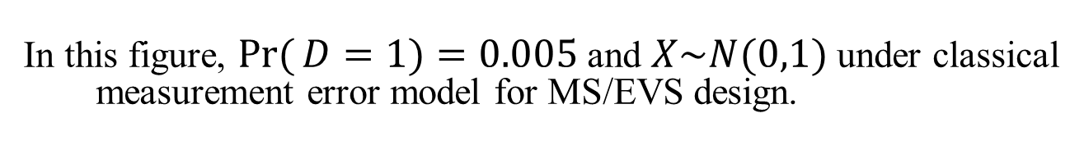
In this figure, $\operatorname{Pr}{(}D=1)=0.005$ and $X\sim N(0,1)$ under classical measurement error model for MS/EVS design.
26
Notes:
26

Slide 27
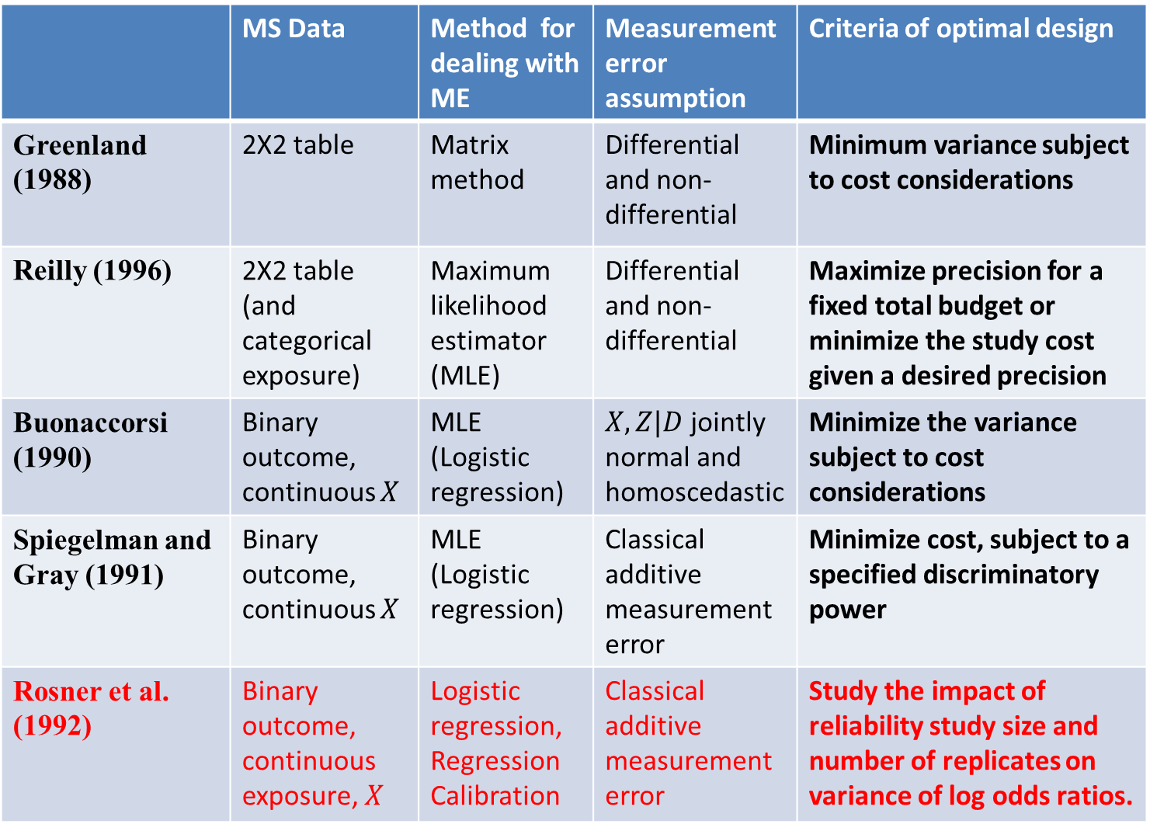
 | MS Data | Method for dealing with ME | Measurement error assumption | Criteria of optimal design
Greenland (1988) | 2X2 table | Matrix method | Differential and non-differential | Minimum variance subject to cost considerations
Reilly (1996) | 2X2 table (and categorical exposure) | Maximum likelihood estimator (MLE) | Differential and non-differential | Maximize precision for a fixed total budget or minimize the study cost given a desired precision
Buonaccorsi (1990) | Binary outcome, continuous $X$ | MLE (Logistic regression) | $X,Z|D$ jointly normal and homoscedastic | Minimize the variance subject to cost considerations
Spiegelman and Gray (1991) | Binary outcome, continuous $X$ | MLE (Logistic regression) | Classical additive measurement error | Minimize cost, subject to a specified discriminatory power
Rosner et al. (1992) | Binary outcome, continuous exposure, $X$ | Logistic regression, Regression Calibration | Classical additive measurement error | Study the impact of reliability study size and number of replicates on variance of log odds ratios.

Slide 28
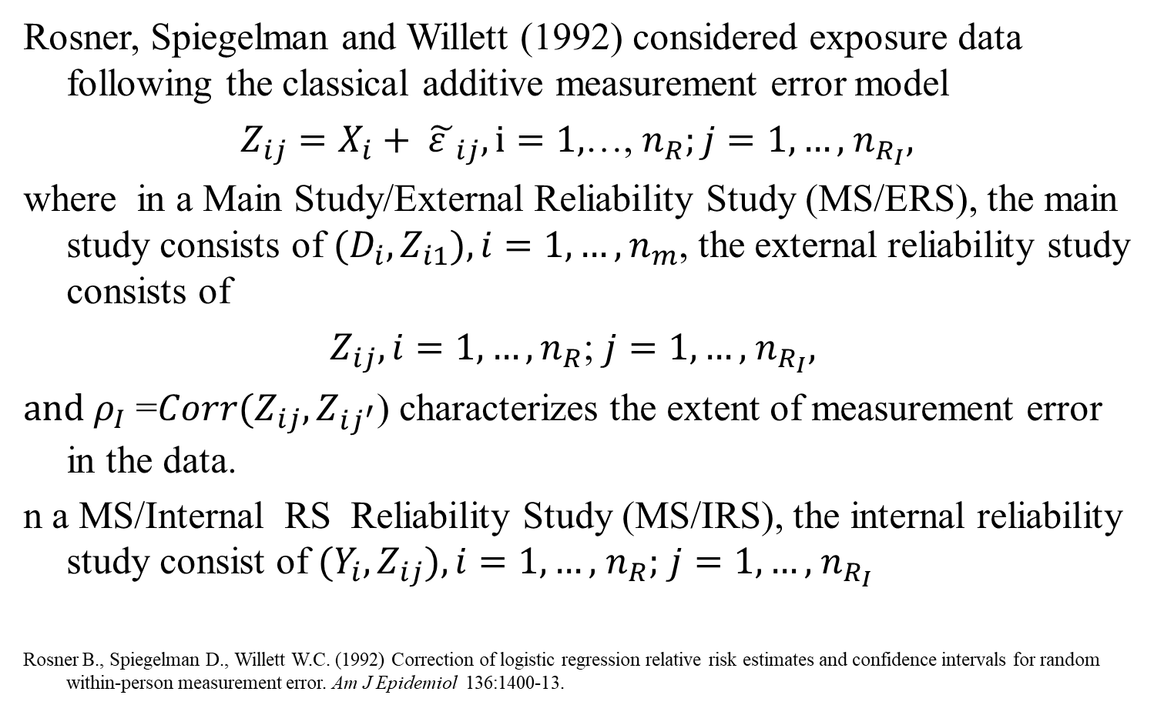
Rosner, Spiegelman and Willett (1992)
Rosner, Spiegelman and Willett (1992) considered exposure data following the classical additive measurement error model
$Z_{ij}=X_{i}+ {\tilde{ε }}_{ij}, i=1,$…, $n_{R};j=1,…,$ $n_{R_{I}},$
where in a Main Study/External Reliability Study (MS/ERS), the main study consists of ${(D}_{i},Z_{i1}), i=1,…,n_{m}$, the external reliability study consists of
$Z_{ij}, i=1,…,n_{R}$; $j=1,…,$ $n_{R_{I}},$
$and ρ_{I}$=$Corr{(Z}_{ij},Z_{ij^{′}}$) characterizes the extent of measurement error in the data.
n a MS/Internal RS Reliability Study (MS/IRS), the internal reliability study consist of ${(Y_{i},Z}_{ij}), i=1,…,$ $n_{R};$ $j=1,…,$ $n_{R_{I}}$
Rosner B., Spiegelman D., Willett W.C. (1992) Correction of logistic regression relative risk estimates and confidence intervals for random within-person measurement error. Am J Epidemiol 136:1400-13.
28
Notes:
28

Slide 29
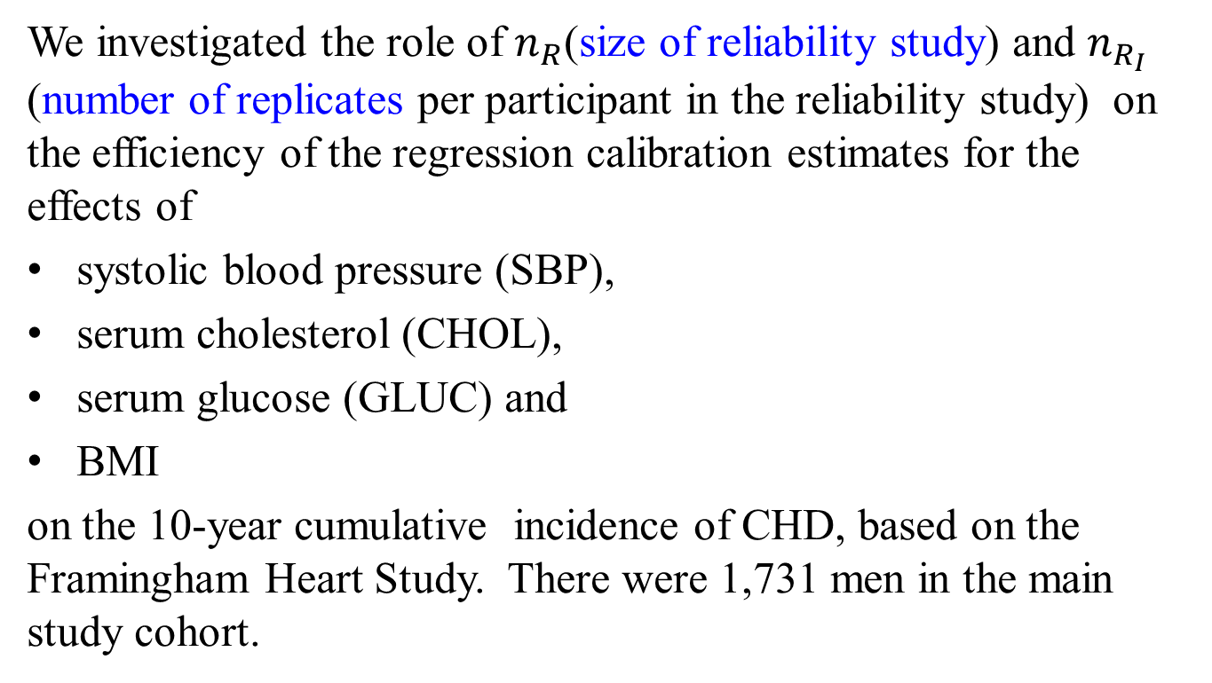
Framingham Heart Study
We investigated the role of $n_{R}$(size of reliability study) and $n_{R_{I}}$ (number of replicates per participant in the reliability study) on the efficiency of the regression calibration estimates for the effects of
systolic blood pressure (SBP),
serum cholesterol (CHOL),
serum glucose (GLUC) and
BMI
on the 10-year cumulative incidence of CHD, based on the Framingham Heart Study. There were 1,731 men in the main study cohort.

Slide 30







It is apparent that as $n_{R}$increases,
the variances of the measurement
error corrected log relative risks
using regression calibration converge to an asymptote.
At small values of $n_{R}$, larger
values of $n_{R_{I}}$ improve the
precision, but once $n_{R}$is greater
than 100 or so, there is very little
advantage over $n_{R_{I}}=2$.
$${SE(\hat{β}}^{∗})$$
$${SE(\hat{β}}^{∗})$$
$${SE(\hat{β}}^{∗})$$
$${SE(\hat{β}}^{∗})$$
$$n_{R_{I}}=2$$
$$n_{R_{I}}=3$$
$$n_{R_{I}}=5$$
$$n_{R_{I}}=10$$
30
Notes:
30

Slide 31
Concept review
Fully validated design
MS/IVS, MS/EVS
MS/IRS, MS/ERS
Sensitivity and Specificity
Random/Non-differential, and non-random/differential misclassification
Reliability coefficient
Optimal design
Unit cost
31
Notes:
31

Slide 32
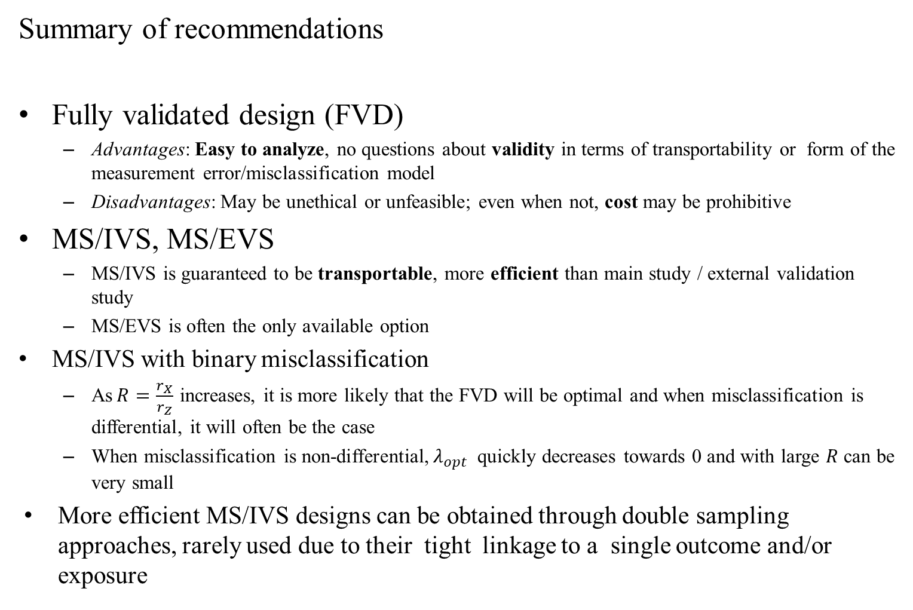
Summary of recommendations
Fully validated design (FVD)
Advantages: Easy to analyze, no questions about validity in terms of transportability or form of the measurement error/misclassification model
Disadvantages: May be unethical or unfeasible; even when not, cost may be prohibitive
MS/IVS, MS/EVS
MS/IVS is guaranteed to be transportable, more efficient than main study / external validation study
MS/EVS is often the only available option
MS/IVS with binary misclassification
As$R=\frac{r_{X}}{r_{Z}}$ increases, it is more likely that the FVD will be optimal and when misclassification is differential, it will often be the case
When misclassification is non-differential,${ λ}_{opt}$ quickly decreases towards 0 and with large $R$ can be very small
More efficient MS/IVS designs can be obtained through double sampling approaches, rarely used due to their tight linkage to a single outcome and/or exposure
32
Notes:
32

Slide 33
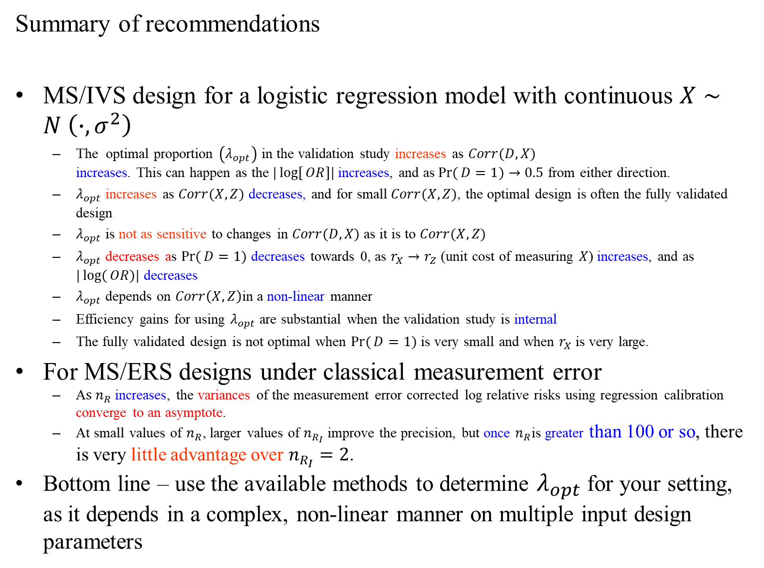
Summary of recommendations
MS/IVS design for a logistic regression model with continuous $X∼N \left(∙,σ^{2}\right)$
The optimal proportion $\left(λ_{opt}\right)$ in the validation study increases as $Corr(D,X)$ increases. This can happen as the$|\log{[}OR]|$ increases, and as$\operatorname{Pr}{(}D=1)→0.5$ from either direction.
$λ_{opt}$increases as $Corr(X,Z)$ decreases, and for small$Corr(X,Z)$, the optimal design is often the fully validated design
$λ_{opt}$is not as sensitive to changes in $Corr(D,X)$ as it is to $Corr(X,Z)$
$λ_{opt}$ decreases as $\operatorname{Pr}{(}D=1)$ decreases towards 0, as $r_{X}→r_{Z}$ (unit cost of measuring $X$) increases, and as $|\log{(}OR)|$ decreases
$λ_{opt}$depends on $Corr\left(X,Z\right)$in a non-linear manner
Efficiency gains for using $λ_{opt}$ are substantial when the validation study is internal
The fully validated design is not optimal when $\operatorname{Pr}{(}D=1)$ is very small and when $r_{X}$is very large.
For MS/ERS designs under classical measurement error
A$s n_{R}$increases, the variances of the measurement error corrected log relative risks using regression calibration converge to an asymptote.
At small values of $n_{R}$, larger values of $n_{R_{I}}$ improve the precision, but once $n_{R}$is greater than 100 or so, there is very little advantage over $n_{R_{I}}=2$.
Bottom line – use the available methods to determine $λ_{opt}$ for your setting, as it depends in a complex, non-linear manner on multiple input design parameters
33
Notes:
33

